Slide 1

Azure Developer – Virtual Mentored Program
DevOps, IaC with ARM Templates, and Azure DevOps CI & CD Pipelines

Slide 2
Week 6 Content
DevOps
IaC with ARM Templates
ADO CI & CD Pipelines

Slide 3
DevOps

Slide 4

Continuous Integration

Slide 5
DevOps – What is it?
How would you define the term “DevOps”. Type your thoughts/answers in the chat or come off mute and share.

Slide 6


Approach Used In the “Olden” Times
#$@&%*!!!
Development
Operations
#$@&%*!!!
Development & Operations siloes
Lack of understanding of the other perspective
Lack of communication & partnership
“Fire and forget” engagement

Slide 7


DevOps – The New Way
Development
Operations
Development & Operations work together
Each understands & appreciates the position of the other
Good communication, partnership, & collaboration
Ongoing engagement – continuous improvement

Slide 8

DevOps – The Three Ways
The First Way: Flow/Systems Thinking
Business
Customer
Source: Gene Kim (https://itrevolution.com/the-three-ways-principles-underpinning-devops/)
Development
Operations
Holistic vs. siloed view – success is defined by the performance of the entire system vs. a specific team or individual
Starts with requirements (defined by the business) and not called “done” until value is delivered to the customer
Target outcomes:
Known defect never passed to downstream teams
Favor global performance vs. focusing on local optimization
Goal is increased flow (value)
Asking ourselves the question: “What don’t I know about our systems?”

Slide 9
DevOps – The Three Ways
The Second Way: Amplify Feedback Loops
Business
Customer
Source: Gene Kim (https://itrevolution.com/the-three-ways-principles-underpinning-devops/)
Development
Operations
Create right-to-left feedback loops
Shorten & amplify so information needed to make continuous improvements & continuous correction is readily available
Target outcomes:
Understanding all customer perspectives (internal & external)
Responding to all customer concerns (internal & external)
Knowledge is power!

Slide 10
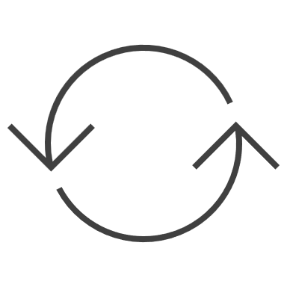
DevOps – The Three Ways
The Third Way: Culture of Continual Experimentation & Learning
Business
Customer
Source: Gene Kim (https://itrevolution.com/the-three-ways-principles-underpinning-devops/)
Development
Operations
Culture that fosters:
Continual experimentation, risk-taking, and learning from failure
Practice makes perfect!
Target outcomes:
Allocating time for continual improvement (e.g., resolution of technical debt as a standard “category” of work)
Taking risks and seeing them pay off – No guts no glory!
Expecting failure & building resiliency into the process

Slide 11





DevOps – Some Key, High-Level Principles
Incremental releases from which we learn
Automation everywhere
Experimentation & failing fast
Continuous feedback & continuous improvement
Continuous delivery (continuous integration, testing, & deployment)

Slide 12
Continuous Delivery
Continuous Integration
Continuous Testing
Continuous Deployment
Continuous Value
Continuous Delivery

Slide 13
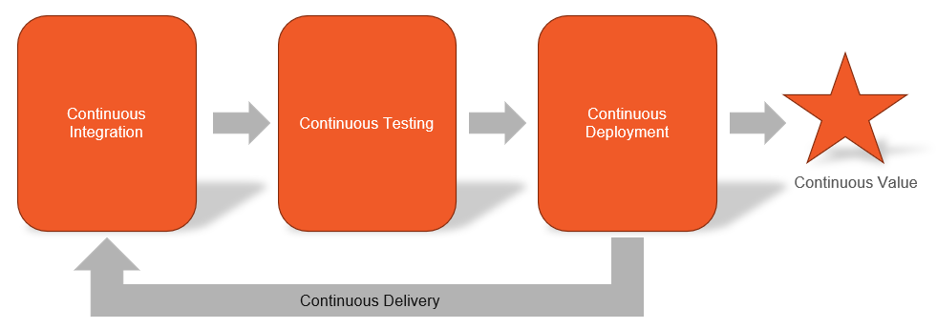
Continuous Integration
Changes from individual developers are merged & system is validated “as a whole”
Code changes are detected & automated processes are executed to assess
Any issues uncovered are communicated to the developers for remediation (feedback)
Targeted testing (i.e., unit testing) executed as part of CI flow

Slide 14
Continuous Integration
Initiation is often event-driven
Rather than waiting for a “critical mass” of changes before starting our testing, each change can be exercised & validated as it gets persisted to the centralized code repository
Amplifies the feedback loop rather than burying in a “sea” of other changes
Sets the stage for multiple types of validation (including security validation, or DevSecOps)

Slide 15
Continuous Integration
Best practices:
Minimize dependencies between features – each feature should be able to stand on its own
Work to drive out manual steps and make automation the priority
Stabilize data sources & other system dependencies through mocking
Include assessment of code quality (e.g., cyclomatic complexity) & unit test coverage as key parts of verification workflow

Slide 16

Continuous Testing

Slide 17
Continuous Testing
Different types of testing:
Unit testing
Regression testing
Integration testing
Functional testing
Acceptance testing
Security testing
Performance testing

Slide 18
Continuous Testing
Different types of testing:
Unit testing
Regression testing
Integration testing
Functional testing
Acceptance testing
Security testing
Performance testing
Testing discrete units of code in isolation from other code. Leverages mocking to stabilize other system dependencies so that tests are repeatable. Code coverage often used to assess quality & sufficiency of unit testing. Should be automated.

Slide 19
Continuous Testing
Different types of testing:
Unit testing
Regression testing
Integration testing
Functional testing
Acceptance testing
Security testing
Performance testing
Testing that verifies that newly introduced changes for development of a feature do not inadvertently break other, existing features. Automated unit tests can also fill the role of a regression test suite nicely.

Slide 20
Continuous Testing
Different types of testing:
Unit testing
Regression testing
Integration testing
Functional testing
Acceptance testing
Security testing
Performance testing
Testing that verifies that groups of components & component features operate correctly when combined with other features. Usually represents a layer above unit testing but below functional testing. Should be automated.

Slide 21
Continuous Testing
Different types of testing:
Unit testing
Regression testing
Integration testing
Functional testing
Acceptance testing
Security testing
Performance testing
Testing that verifies functional requirements for critical workflows in the software end-to-end. Can be (and probably should be) implemented as automated black box tests, requiring minimal knowledge & minimal assumptions about the inner workings of the software.

Slide 22
Continuous Testing
Different types of testing:
Unit testing
Regression testing
Integration testing
Functional testing
Acceptance testing
Security testing
Performance testing
Testing that verifies the functionality of the software against specific acceptance criteria defining the difference between “good” & “bad”. May include manual testing/utilization by a subset of testers to verify that the software will operate correctly when leveraged by end users in production.

Slide 23
Continuous Testing
Different types of testing:
Unit testing
Regression testing
Integration testing
Functional testing
Acceptance testing
Security testing
Performance testing
Testing that verifies the functionality of the software against critical security requirements as identified & prioritized via threat modeling. Through a combination of static & dynamic testing, assesses the software for security vulnerabilities or deficiencies from a compliance & regulatory perspective (A.K.A. DevSecOps).

Slide 24
Continuous Testing
Different types of testing:
Unit testing
Regression testing
Integration testing
Functional testing
Acceptance testing
Security testing
Performance testing
Testing that verifies that the software will meet defined SLAs (Service Level Agreements) when exercised under load or stress. Can also be used to validate the software’s ability to elastically scale (out or in) based on volumes.

Slide 25

Moment of Reflection
Answer the following question: Which type of testing is most critical when compared to the other types?
Type your answer in chat
Different types of testing:
Unit testing
Regression testing
Integration testing
Functional testing
Acceptance testing
Security testing
Performance testing

Slide 26
Moment of Reflection
Answer the following question: Which type of testing is the hardest to “get right”?
Type your answer in chat
Different types of testing:
Unit testing
Regression testing
Integration testing
Functional testing
Acceptance testing
Security testing
Performance testing

Slide 27
Continuous Testing
How does Continuous Integration help promote software quality?
Maximizes the use & benefits of automation to enable “early & often”
Provides multiple “hooks” within the workflow for plugging in the various types of testing
Enables integration of testing results into the pipeline as quality gates
Accelerates test result feedback for visibility & effective disposition

Slide 28

Continuous Testing
Information gathered from early phases feed into later phases
In true DevOps fashion, lessons learned feed continuous improvement
Release
Plan
Operate
Test
Develop
Feedback
Quality gates guard against moving security defects forward

Slide 29

Continuous Deployment

Slide 30
Continuous Deployment
Does not necessarily mean continuously deployed, but rather continuously ready to deploy
Through a release pipeline, seeks to push latest version of the software through the environments at the frequency required by the business
Intended to help get innovation “quickly” into the hands of users & customers for serving needs & gathering feedback

Slide 31
Continuous Deployment
Version management:
Often leverages semantic versioning (major.minor.patch)
Often leverages explicit versioning
Seeks to keep a clear distinction & separation between each version of the software
Goal is version traceability & visibility when upgrade is possible, or rollback is required
Notes:
Talk about what each aspect of semantic versioning means:
Patch – bug fixes
Minor – enhancements but expected to remain backwards compatible
Major – likely breaking change

Slide 32
Continuous Deployment
Blue/Green testing:
Maintains two (or more) identical hosting environments
Provides the opportunity to run multiple versions of the software in parallel
Production traffic is managed through routing – switch routing from old to new, & verify
If issues uncovered, routing can be switched back to previous version for quick rollback

Slide 33
Continuous Deployment
Canary testing:
Provides the opportunity to run multiple versions of the software in parallel
Small portion of traffic can be routed to new version to ease in adoption
Allows verification of new version in lower risk manner (like a canary in a coal mine)
As confidence in new version builds, more and more traffic can be transitioned over until new version is used exclusively

Slide 34
IaC with ARM Templates

Slide 35
IaC – What is it?
IaC stands for Infrastructure-as-Code
Strategy in modern DevOps used to quickly create consistent instances of the infrastructure required to run your systems and applications
Helps us codify infrastructure definitions (just like application code)
What kind of possibilities does this open up for us?

Slide 36
IaC – Benefits
Infrastructure definitions can be unit tested
Infrastructure definitions can be source controlled
Infrastructure definitions can be versioned
Infrastructure can be created and recreated consistently across all environments

Slide 37
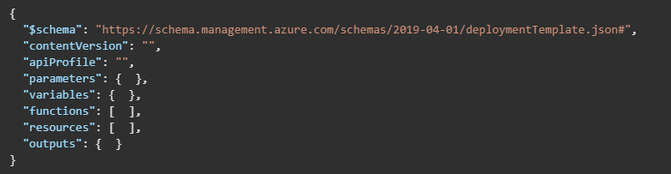
Azure Resource Manager (ARM) Templates
Microsoft’s JSON-based IaC solution
Supports definition of Cloud resources for Azure in code that adheres to a predefined schema
Going to briefly look at details for just a few of the available elements
Source: https://learn.microsoft.com/en-us/azure/azure-resource-manager/templates/syntax

Slide 38
$schema Element
Location of schema file that defines target version of template language
Used to enforce rules around properties, hierarchy, and values applied to each
Can be used to automate validation of a given ARM template instance
Source: https://learn.microsoft.com/en-us/azure/azure-resource-manager/templates/syntax

Slide 39
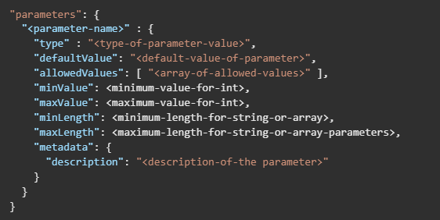
parameters Element
Optionally allows specification of values that can be inputs at deployment time
Limited to 256 parameters in a given template
Source: https://learn.microsoft.com/en-us/azure/azure-resource-manager/templates/syntax

Slide 40
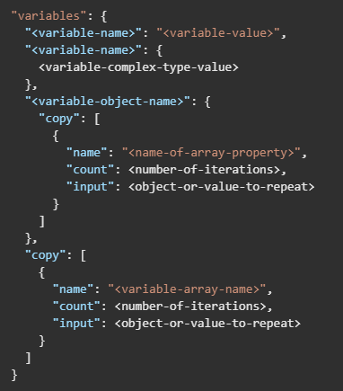
variables Element
Optionally allows definition of variables that can be used throughout template – similar to variables used in application code
Can help reduce complex expressions through reusability
Source: https://learn.microsoft.com/en-us/azure/azure-resource-manager/templates/syntax
Notes:
See https://learn.microsoft.com/en-us/azure/azure-resource-manager/templates/variables for additional detail

Slide 41
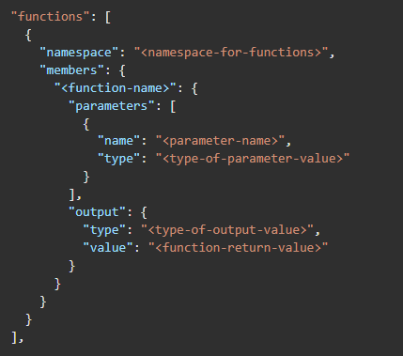
functions Element
Optionally allows definition of user-defined, custom functions
Allows encapsulation of complex expressions/instructions that are callable by name
Source: https://learn.microsoft.com/en-us/azure/azure-resource-manager/templates/syntax

Slide 42
resources Element
Required section of template that enables the definition of the actual resources to be deployed
See source URL for additional info
Source: https://learn.microsoft.com/en-us/azure/azure-resource-manager/templates/syntax

Slide 43
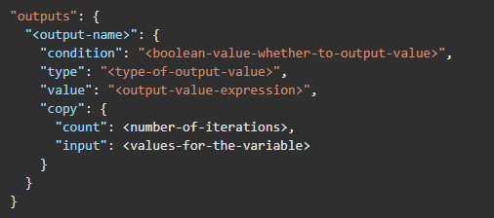
outputs Element
Defines values returned from a deployment (i.e., outputs from execution of the deployment)
Can be used to return details from deployed resources (e.g., public DNS value)
Source: https://learn.microsoft.com/en-us/azure/azure-resource-manager/templates/syntax

Slide 44
Azure Resource Manager (ARM) Templates
Lab
Notes:
https://learn.microsoft.com/en-us/azure/virtual-machines/linux/quick-create-template?toc=%2Fazure%2Fazure-resource-manager%2Ftemplates%2Ftoc.json
Create an Ubuntu Linux virtual machine using an ARM template

Slide 45
Azure Resource Manager (ARM) Templates
Lab
Notes:
https://learn.microsoft.com/en-us/azure/storage/common/storage-account-create?toc=%2Fazure%2Fazure-resource-manager%2Ftemplates%2Ftoc.json&tabs=azure-portal
Create a storage account

Slide 46
ADO CI & CD Pipelines

Slide 47
ADO CI & CD Pipelines
Demo
Notes:
https://errolpereira.github.io/how_to_create_CI_CD_pipeline_using_azure_devops/#:~:text=How%20to%20create%20simple%20CI%2FCD%20pipeline%20using%20Azure,run%20button.%20...%204%204.%20CI%2FCD%20Automation%20

Slide 48




Thank you!
If you have additional questions, please reach out to me at:
(email address)
Notes:
Mandatory -- Need bookend -- first and last thing they should see is DevelopIntelligence
ACTION: Use this for the final slide of your class materials. Include contact information so participants can reach you if they have questions after the course.

